Slide 1

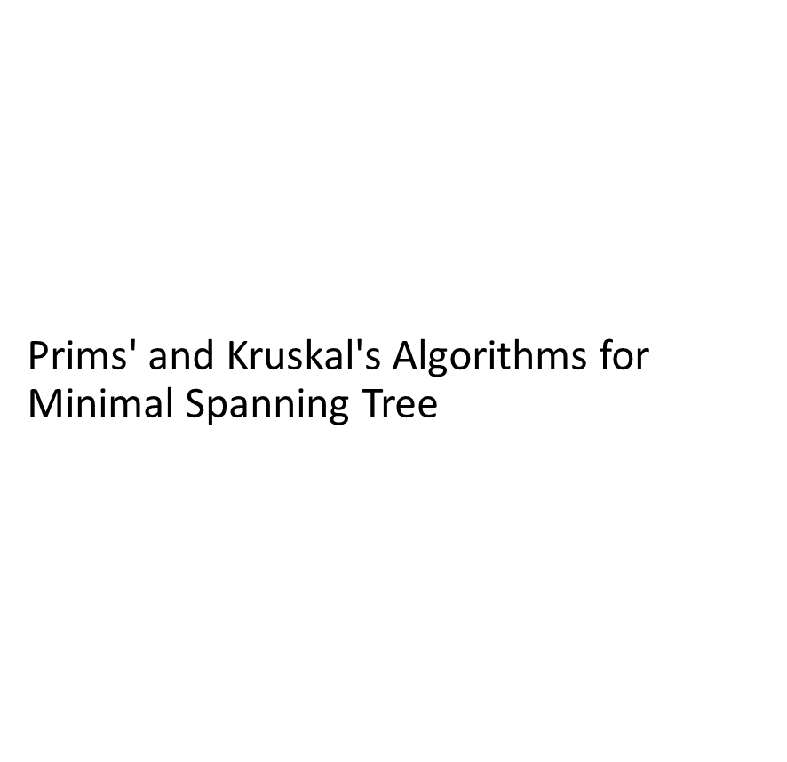

Slide 2

Spanning Trees:
A subgraph T of undirected graph G =(V,E) is a spanning tree of G if it is a tree and contains every vertex in G.

Slide 3
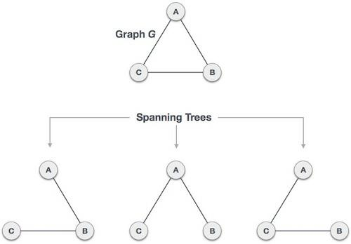

Slide 4
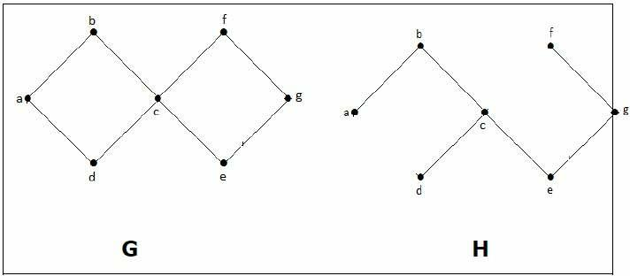

Slide 5

Weighted graph
Each edge in the graph has a weight(some real number)
Weight of a graph is sum of weights ofall edges

Slide 6
Minimal spanning tree(MST)
A Minimum Spanning Tree in an undirected connected
weighted graph is a spanning tree of minimum weight
(among all spanning trees).

Slide 7
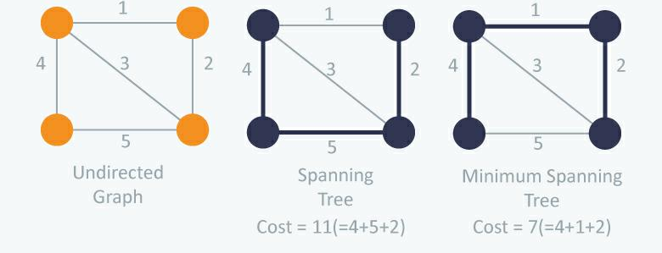

Slide 8
The minimum cost spanning tree has wide applications in different fields. It represents many complicated real world
problems like:
Minimum distance for travelling all cities at most one (Travelling salesman problem).
In electronic circuit design, to connect n pins by using n-1 wires, using least wire.
Spanning tree also finds their application in obtaining an independent set of circuit equations for an electrical network.

Slide 9
The minimum cost of spanning tree can be implemented using two methods:
1. Prim’s Algorithm
2. Kruskal’s Algorithm

Slide 10
Prim’s Algorithm
Greedy method to obtain MST
Build tree edge by edge
Next edge to include –according to optimization criterion
Simplest method- edge results minimum increase in sum of cost of edges so far included

Slide 11
If A is set of seleted edges so far form a tree
Next edge(u,v) included in A is minimum cost edge, not in A with property A U (u,v) also a tree

Slide 12
Idea of algorithm
Start with a tree that include only minimum cost edge of G
Edges added one by one (i,j) added if i already in tree, j not included yet.
Cost(i,j) is cost[i,j]
Cost[I,J] is minimum among all edges (k,l) such that k in tree and l not in tree

Slide 13
For each vertex j, not included in tree,near[j] is value Included
Near[j] , vertex in tree such that cost(j,near[j]) is minimum among all choices of near[j]
Set near[j] =0 for all j already in tree.

Slide 14
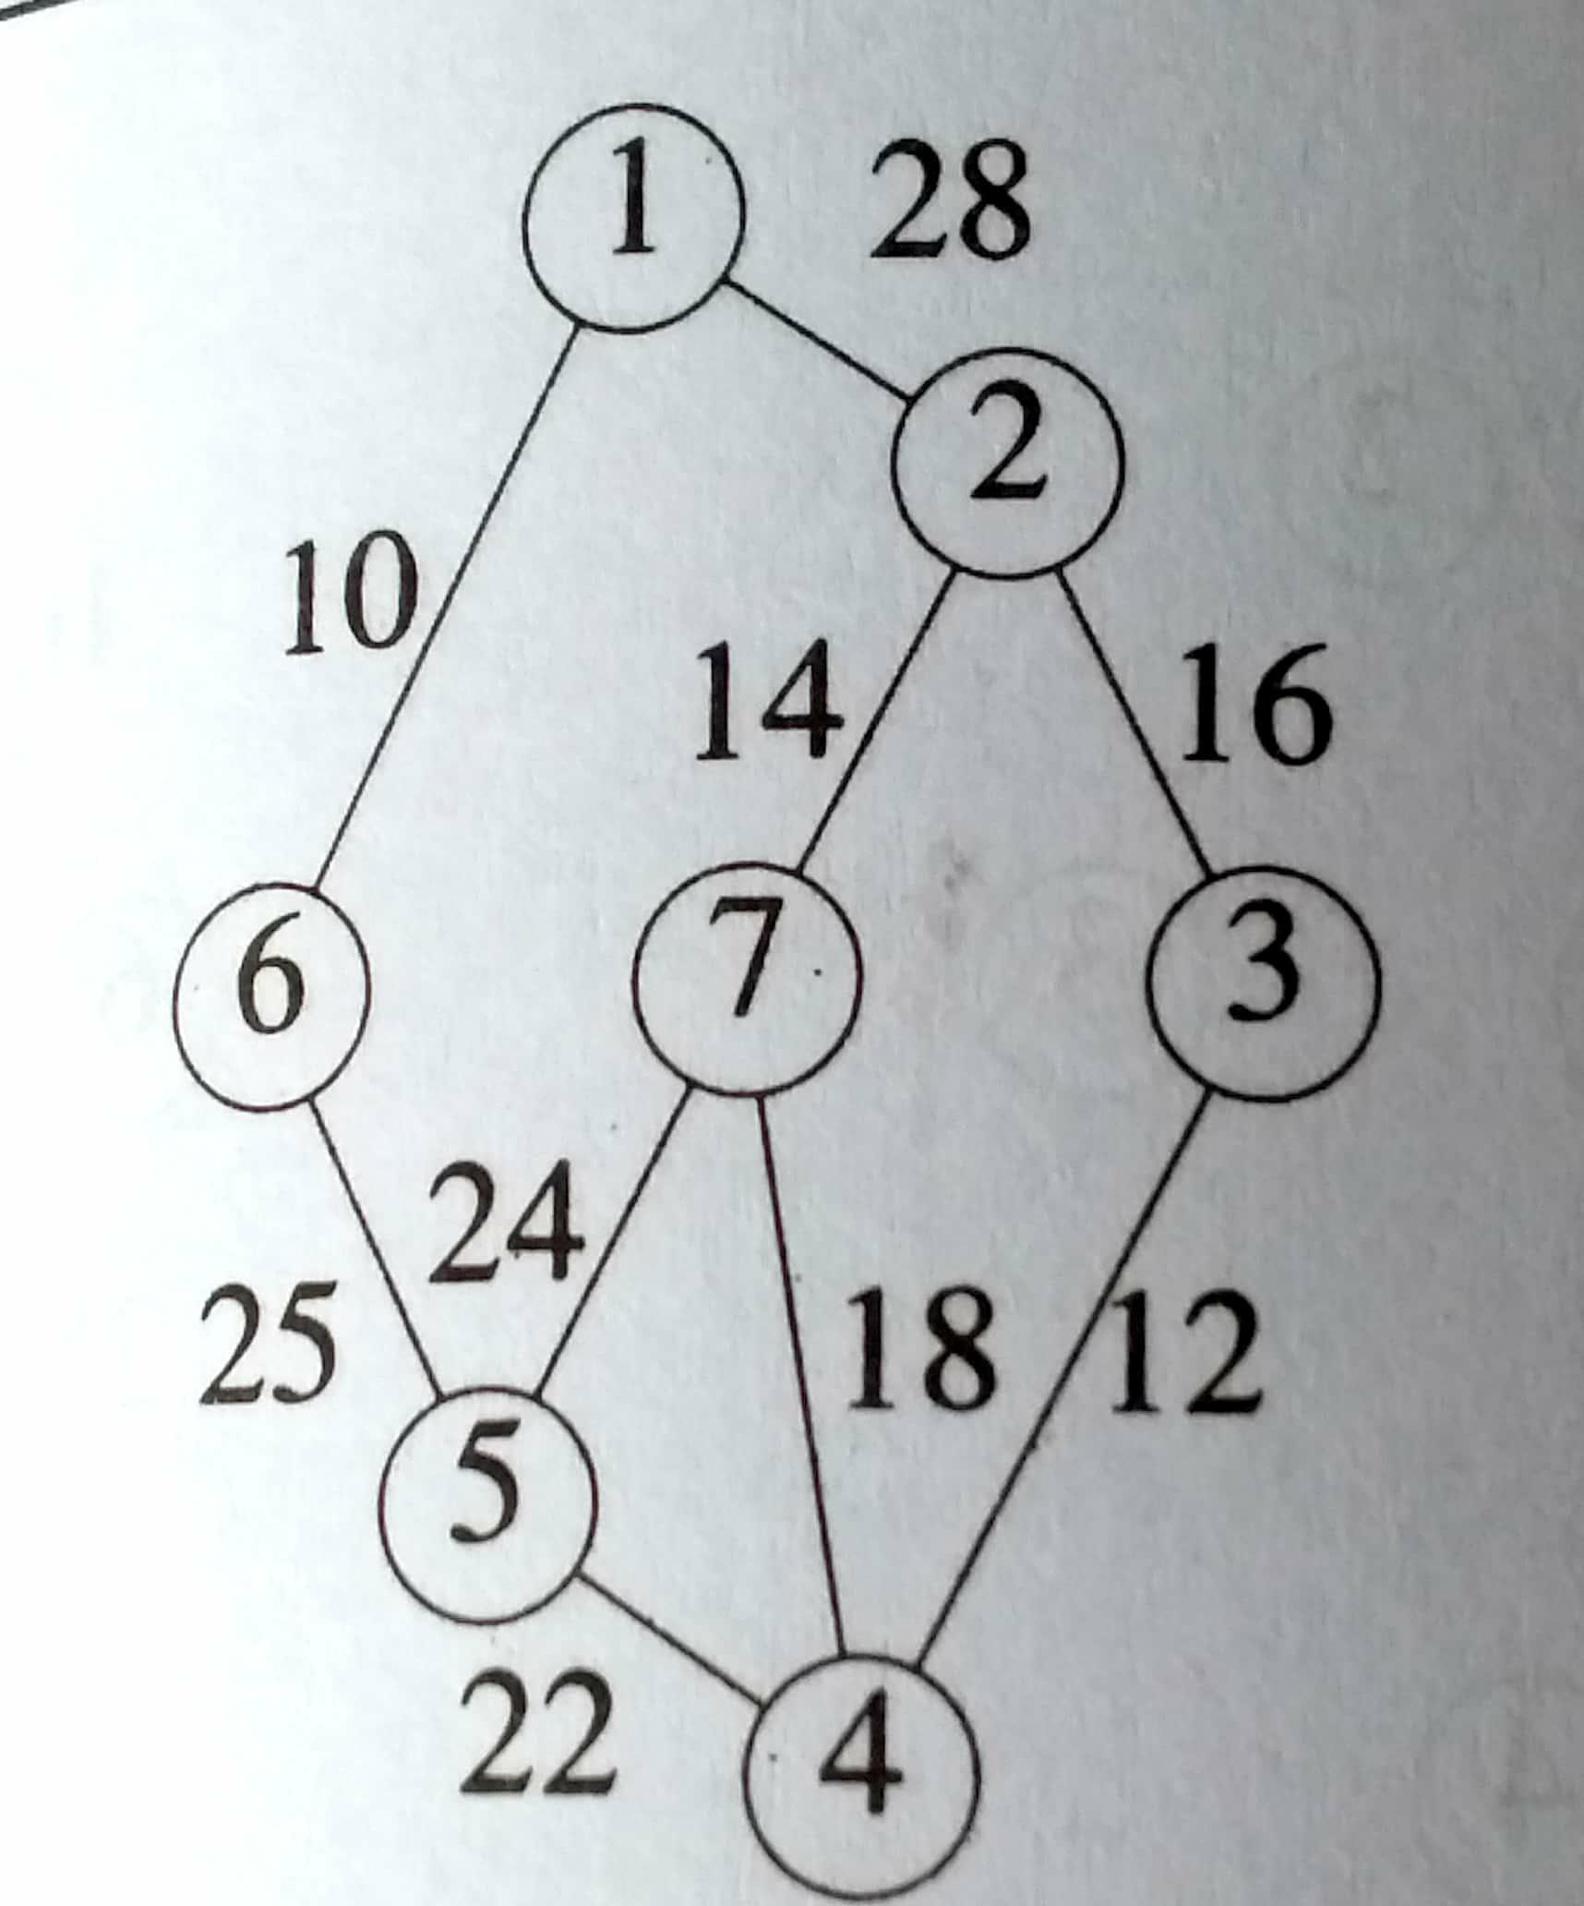

Slide 15
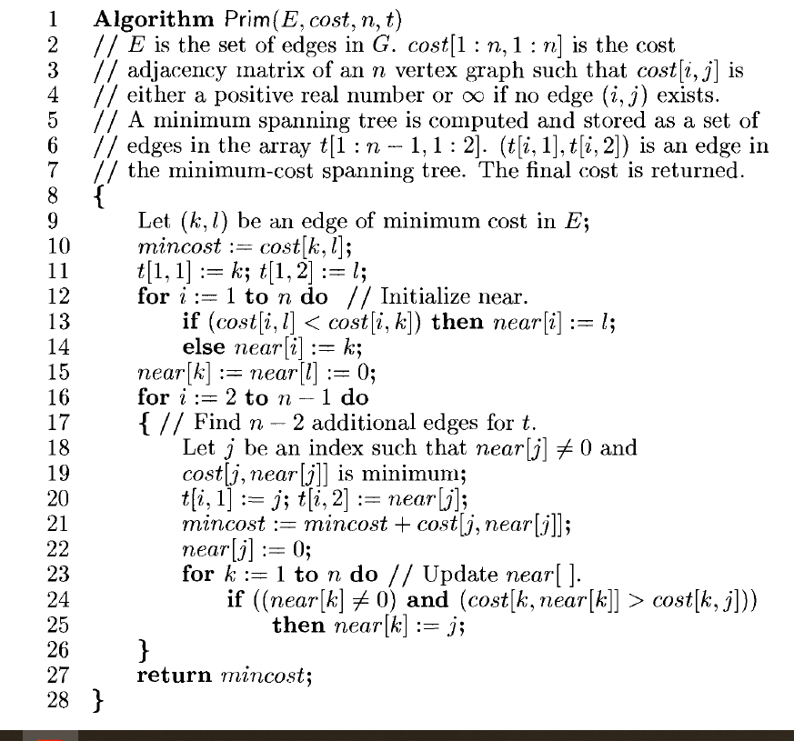

Slide 16
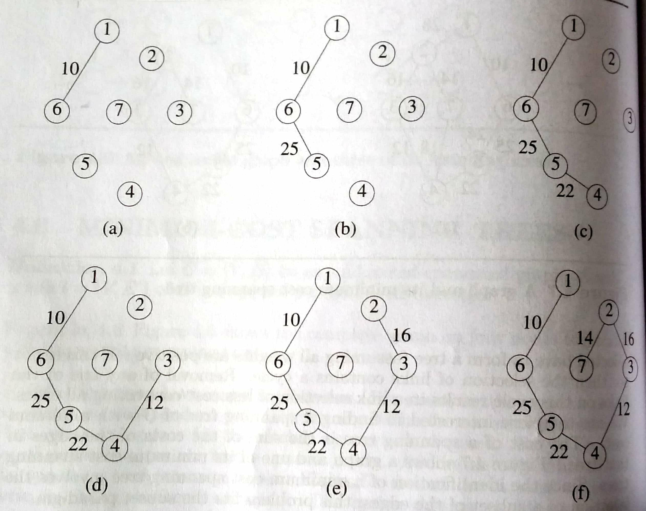

Slide 17
The algorithm will start with a tree that includes only a minimum-cost edge of G.
Then, edges are added to this tree one by one.
The next edge(i,j) to be added is such that i is a vertex already included in the tree,j is a vertex not yet included and the cost of (i,j),cost[i,j] is,minimum among all edges {k,l)such that vertex k is in the tree and vertex I is not in the tree.
To determine this edge(i,j) efficiently, we associate with each vertex j not yet included in the tree a value near[j]
The value near[j] is a vertexin the tree such that cost[nj,ear[j]] is minimum among all choices for near[j]
We define near[j]= 0 for all vertices j that are already in the tree.
The next edge include is defined by the vertex j such that near[j]!= 0 (j not already in
the tree) and cost[nj,ear[j]i]s minimum

Slide 19
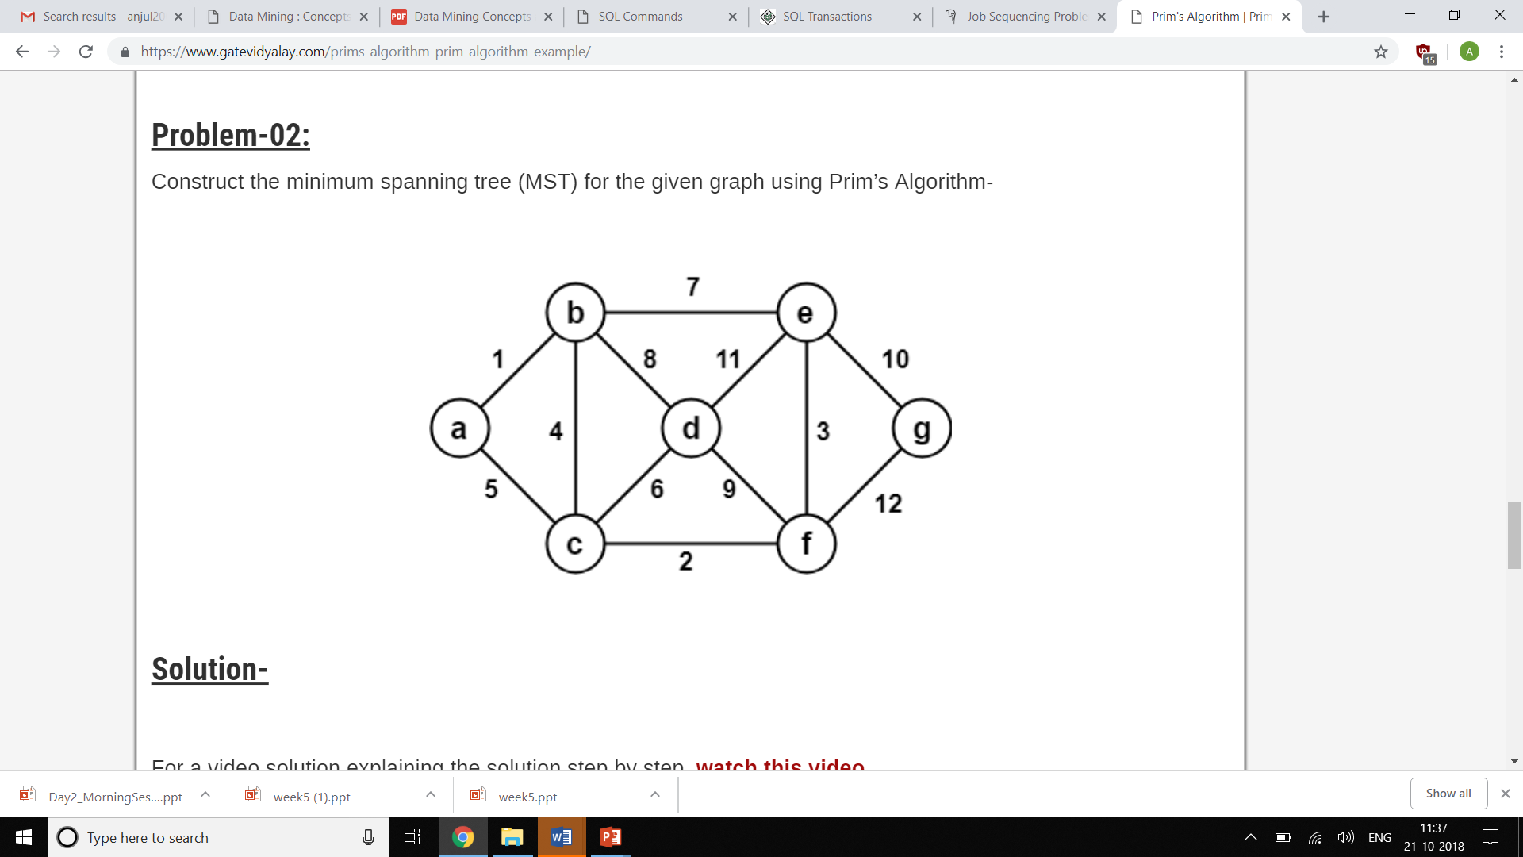
Problem –
Construct the minimal spanning tree for the given graph using Prim’s algorithm

Slide 20
Answer
Weight of the MST
= Sum of all edge weights
= 1 + 4 + 2 + 6 + 3 + 10
= 26 units

Slide 22
Minimum Connector Algorithms
Kruskal’s algorithm
Select the shortest edge in a network
Select the next shortest edge which does not create a cycle
Repeat step 2 until all vertices have been connected
Prim’s algorithm
Select any vertex
Select the shortest edge connected to that vertex
Select the shortest edge connected to any vertex already connected
Repeat step 3 until all vertices have been connected

